Slide 1
LESSON 5

Slide 2
Classroom rules
1. Be on time
2. Be interactive
3. 100% or Nothing
4. Do all Daily Challenges

Slide 3
Review
Các cụm từ học được từ DC:
Make a mistake
Make some coffee
Make noise
Make an appointment
make a bed
Make a choice
Make a film
Make a mess
Make dinner
Ask for the bill
Make me feel happy
Ask me for address
-
-
-
-
-
-
say/said, tell/told + sb
Tell me when you go to school
She said “This is wonderful”
Can I ask you a question?
Ask sb to V: I ask you to make my bed
She asks me to clean her house
Ask sb for sth: She asks me for an umbrella

Slide 4
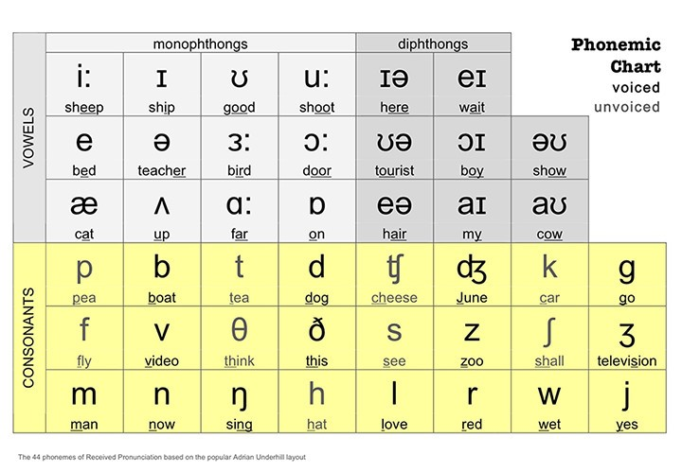

Slide 5
OBJECTIVES
Quy tắc đọc phiên âm từ
Review: Vocabulary
Practice: Speaking

Slide 6
/fəˈget/
Notes:
HV thử đọc -> giữ khẩu hình + trọng âm

Slide 7
Quy tắc đọc phiên âm từ
Quy tắc giữ khẩu hình miệng
Quy tắc nhấn trọng âm từ

Slide 8
Syllable
/ˈsɪ.lə.b(ə)l/
Notes:
Mấy âm tiết -> why -> so sánh với số nguyên âm

Slide 9
Syllable
Mỗi âm tiết là 1 tiếng phát ra
Số âm tiết = số nguyên âm

Slide 10
/prəˌnʌn.siˈeɪ.ʃən/
Notes:
Đọc -> nxet trọng âm đọc ntn (to, cao, dài)

Slide 11
STRESS
To hơn
Cao hơn
Dài hơn

Slide 12
Cách đọc phiên âm
B1: Xác định số âm tiết (dựa vào số nguyên âm)
B2: Xác định trọng âm
B3: Thêm dấu cho từng âm tiết (trọng âm: to hơn, cao hơn, dài hơn)
B4: Đọc từ chậm => nhanh
Lưu ý: Giữ nguyên khẩu hình miệng của từng âm trong từ

Slide 13
Read these words
/saɪˈkɒlədʒi/ | psychology | /ˌɪn.fəˈmeɪ.ʃən/ | information
/ˈelɪfənt/ | elephant | /ˈdɪfɪkəlt/ | difficult
/ˈkɒntɪnənt/ | continent | /fəˈsɪlɪti/ | facility
/dɪsˈɡʌstɪŋ/ | disgusting | /ɒptɪˈmɪstɪk/ | optimistic
/tekˈnɒlədʒi/ | technology | /rɪsˈpɒnsəbl/ | responsible
Notes:
Bài C trang 30

Slide 14
"The future belongs to those who believe in the beauty of their dreams."
[ðə ˈfjutʃər bɪˈlɔŋz tuː ðoʊz huː bɪˈliːv ɪn ðə ˈbjuti ʌv ðeər dri:mz]

Slide 15
"Don't watch the clock; do what it does. Keep going."
[doʊnt wɑ:tʃ ðə klɒk; duː wʌt ɪt dəz. ki:p ˈɡoʊɪŋ]

Slide 16
"Your time is limited, so don't waste it living someone else's life."
[jʊr taɪm ɪz ˈlɪmɪtɪd, soʊ doʊnt weɪst ɪt ˈlɪvɪŋ ˈsʌmwʌnz ˈelsɪz ˈlaɪf]

Slide 17



How do we ask and tell the time?
Excuse me, what’s the time?
Do you have the time?
What time is it now?
Can you tell me the time, please?
Do you know what time it is?
It’s 1 o’clock.
Notes:
Cho nghe trước

Slide 18
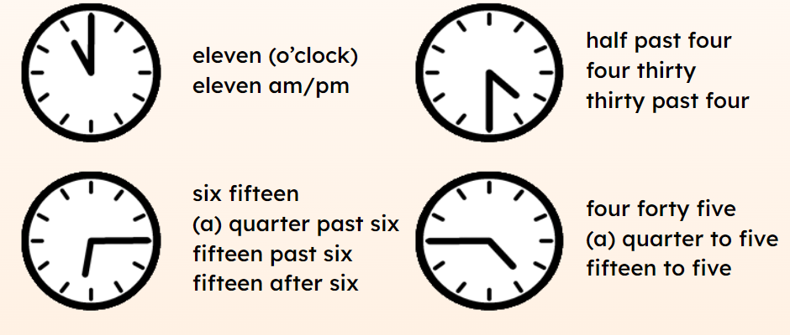

Slide 19








Practice
? Work in pairs: Ask and tell the time.
1.
2.
3.
4.
5.
6.
7.
8.

Slide 20
Practice
1. What time does he work until today?
“I have to work until ………………………..…………………. today.”
four thirty (4:30)

Slide 21
Practice
2. What time does he finish work tonight?
“Tonight, I finish working at …………………………………………..”
half past nine (9:30)

Slide 22
Practice
3. What time will they meet?
“Let’s meet outside of the restaurant at ………………………..…………………………..”
a quarter after seven (7:15)

Slide 23
Practice
4. What time is it right now?
“Right now, it’s ……………………..…………………………………………….
Let’s take a break in ten minutes.”
twenty minutes after three (3:20)

Slide 24
Practice
5. What time is it right now?
“It’s ………………………………………… right now.”
twenty to nine (8:40)

Slide 25
Practice
6. What time is it right now?
“Our train leaves at 7 o’clock. It’s ………..…………………………… right now. Hurry up, let’s run, we’re going to be late!”
three to seven (6:57)

Slide 26
Practice
7. What time is it?
“It’s …………………………………….…………..
The movie starts in 15 minutes.”
a quarter to eight (7:45)

Slide 27
Practice
8. What time is it?
“It’s not 5 o’clock yet. It’s …………………………………………………”
eight minutes to five (4:52)

Slide 28
/ˈek.sə.saɪz/
Do some EXERCISES
Do you do EXERCISES every day?

Slide 29
/ˈwɒʃ.ɪŋ/
Do the WASHING (UP)
Who does the washing (up) in your family?

Slide 30
/ʃaʊər/
Have (take) a SHOWER
What time do you often have a shower?

Slide 31
/ˈbrek.fəst/
Have BREAKFAST
What do you often have for breakfast?

Slide 32
/ˈmer.id/
Get MARRIED
My (brother) got married (last week).

Slide 33
/ˈsaɪtˌsiː.ɪŋ/
Go SIGHTSEEING
Do you like going sightseeing when you’re on holiday?

Slide 34
/wɔːk/
Go for a WALK
How often do you go for a walk?

Slide 35
/ˈməʊ.tə.baɪk/
Go by MOTORBIKE
How do you often go to school/work?

Slide 36
Do you do exercises every day?
Who does the washing (up) in your family?
What time do you often have a shower?
What do you often have for breakfast?
Do you like going sightseeing when you’re on holiday?
How often do you go for a walk?
How do you often go to school/work?

Slide 37



